Slide 1
Adam Koa
Resume
Section 2
Section 3

Slide 2
Adam Koa
Resume
Section 2
Section 3
R&D Mechatronics Engineer
ReDeTec Inc.
May 2022 - Ongoing
R&D Mechatronics Engineer
ReDeTec Inc.
May 2022 - Ongoing
R&D Mechatronics Engineer

Slide 3
Adam Koa
Resume
Section 2
Section 3
Mechatronics Engineer
Mechatronics Engineer
Mechatronics Engineer

Slide 4
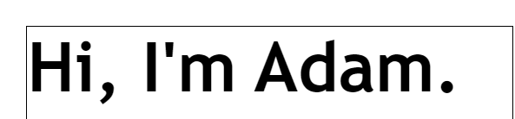

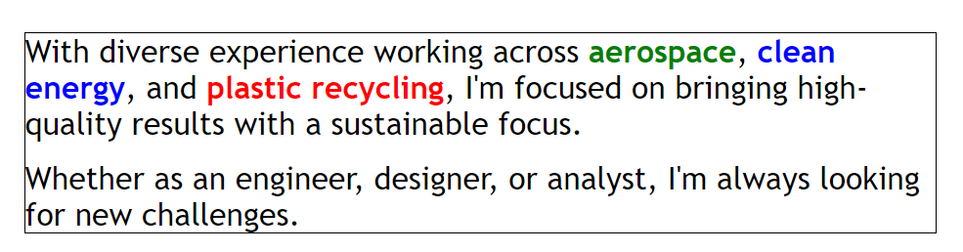
Adam Koa

